Slide 1

Choosing the Right Statistical Test
A Framework for Making Informed Decisions
Presenter: [Your Name]
June 23, 2025

Slide 2




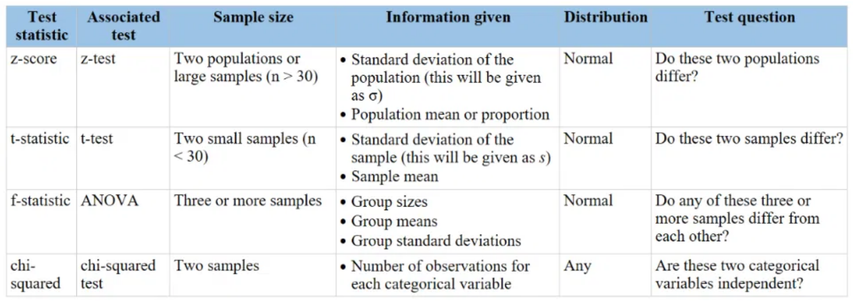

Why Does Test Selection Matter?
Drawing accurate conclusions from your research data
Avoiding misleading results that could lead to incorrect interpretations
Ensuring research validity and scientific integrity
Ethical considerations in data analysis and reporting

Slide 3
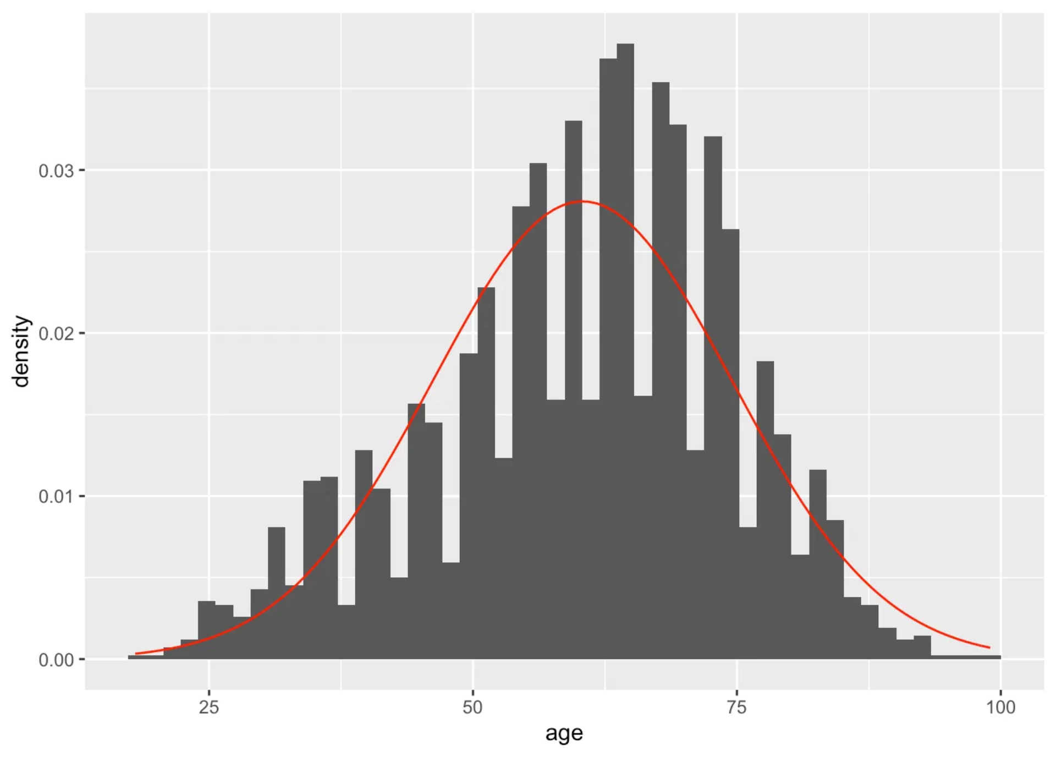
Key Questions Before Choosing a Test
What is your research question?
Is there a difference? Is there a relationship? Is there an effect over time?
What type of data do you have?
Nominal, Ordinal, Interval, Ratio
How many groups/variables are you comparing?
Two, three+, paired, independent
Are your data normally distributed?
Parametric vs. Non-parametric
Are your observations independent?
Independent vs. Dependent samples

Slide 4

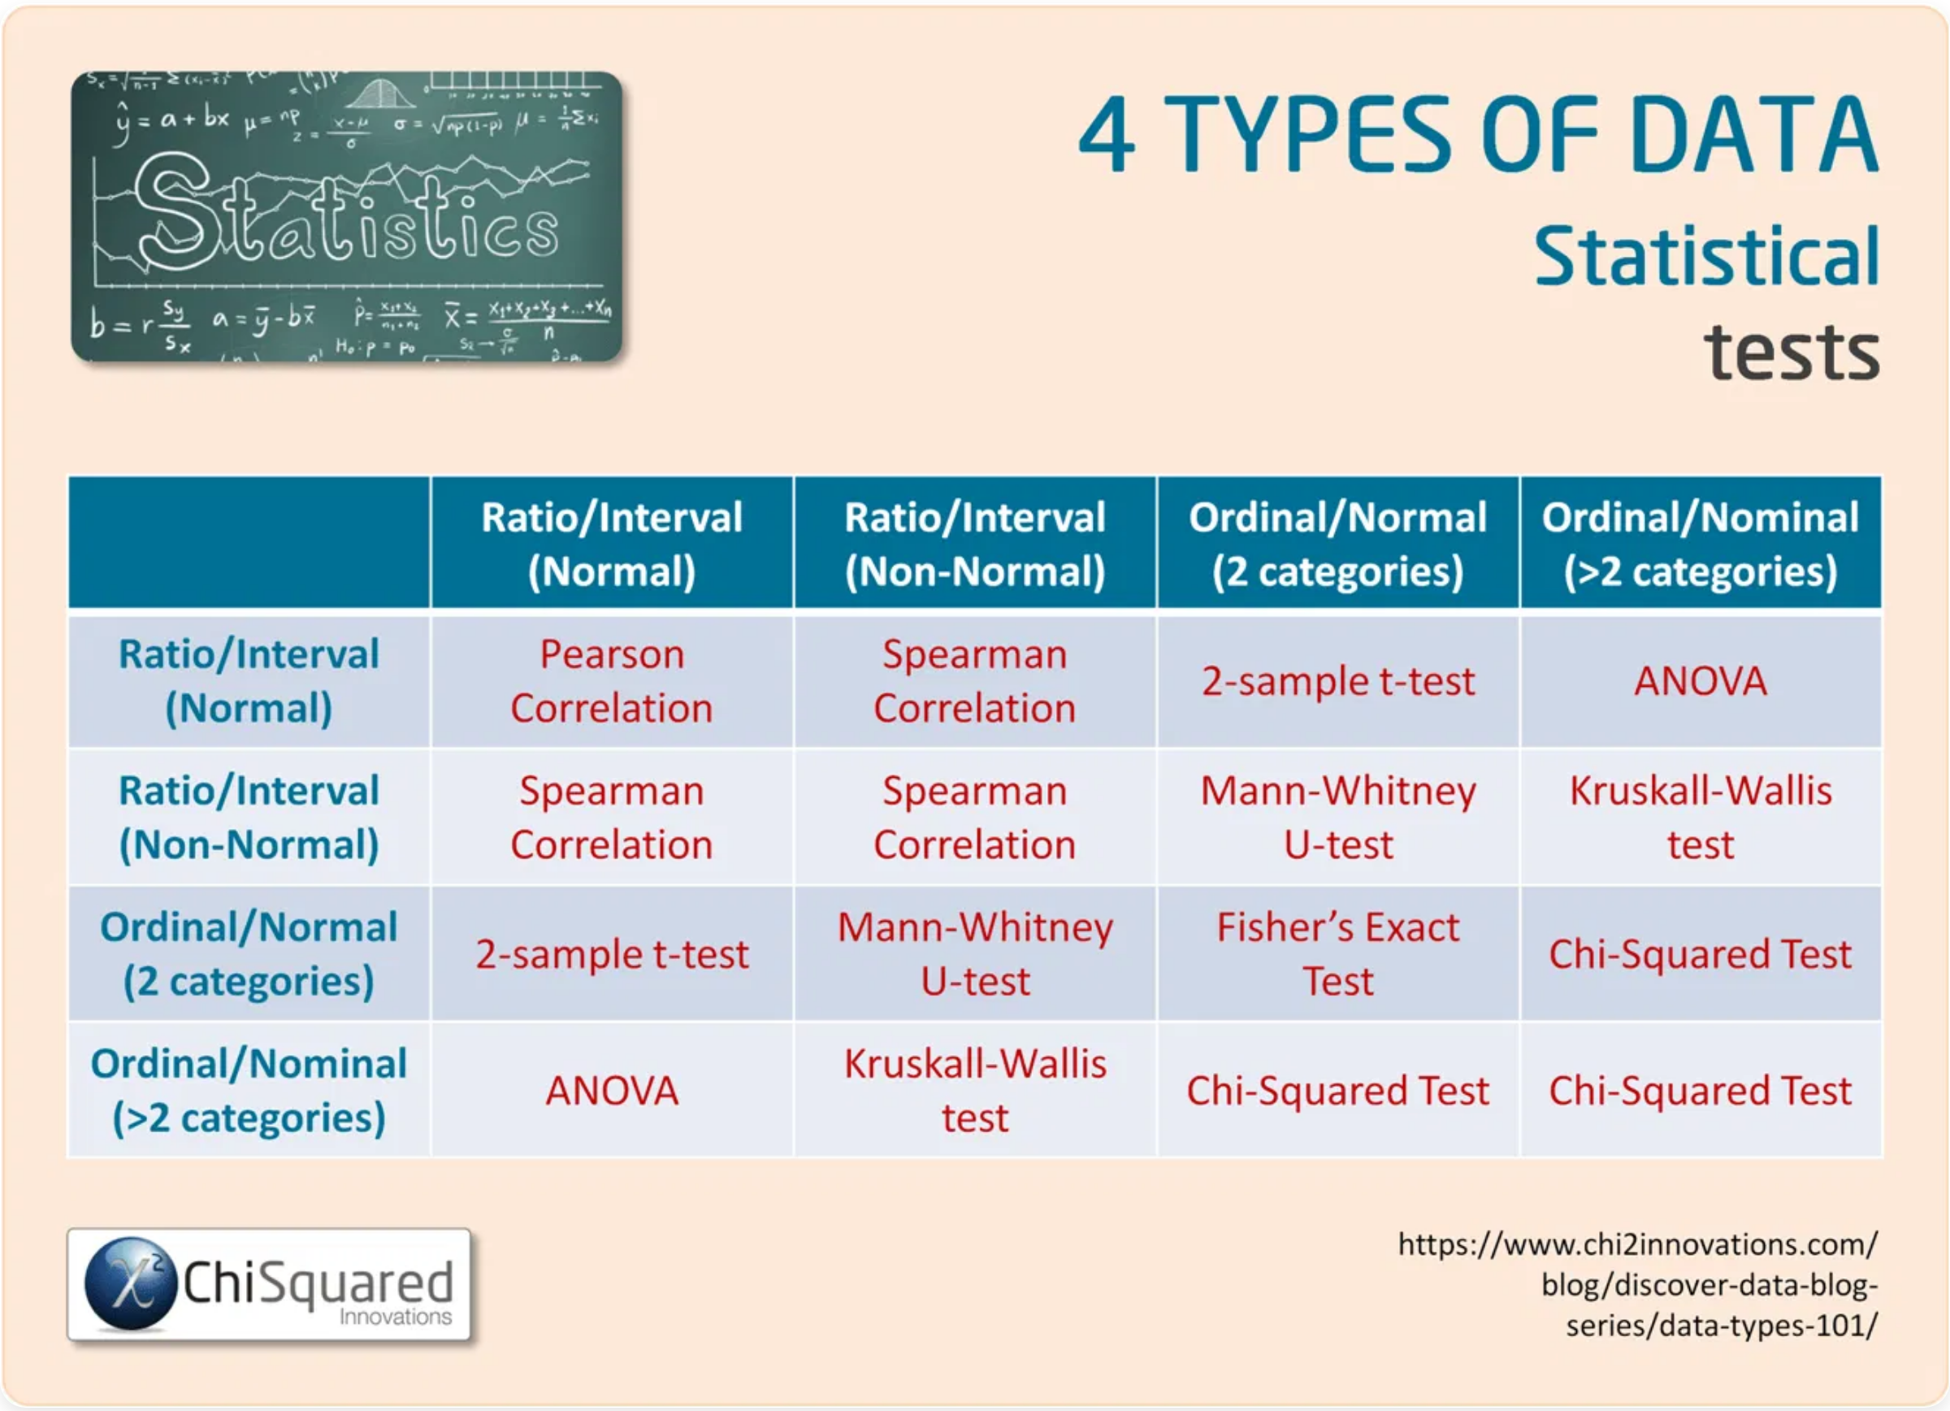
Types of Data with Examples
Understanding the four levels of measurement
Nominal Data
Categorical data with no inherent order or ranking.
Examples: Gender, Blood type, Ethnicity, Colors, Yes/No responses
Ordinal Data
Categorical data with a clear order or ranking, but intervals between values may not be equal.
Examples: Education level, Satisfaction ratings, Likert scales (1-5), Medal rankings (Gold, Silver, Bronze)
Interval Data
Numerical data with equal intervals between values, but no true zero point.
Examples: Temperature in Celsius/Fahrenheit, Calendar dates, IQ scores, pH scale
Ratio Data
Numerical data with equal intervals and a true zero point, allowing for meaningful ratios.
Examples: Height, Weight, Age, Income, Time, Distance, Temperature in Kelvin

Slide 5

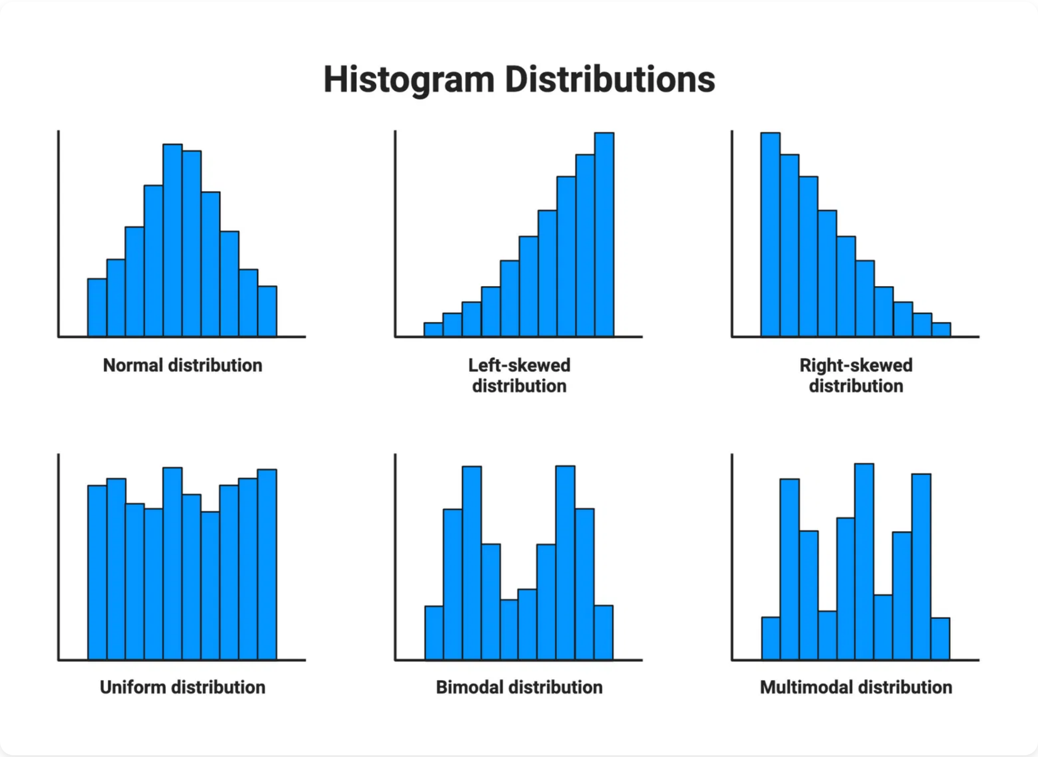



What is Distribution?
Understanding how data is spread and shaped
A
distribution
is the pattern of variation in a dataset,
showing how frequently different values occur and how
they are spread out. It helps us understand the central
tendency, variability, and shape of our data.
Normal Distribution
Symmetrical, bell-shaped curve with most values clustering around the mean. Example: Heights in a population.
Skewed Distribution
Asymmetrical with a longer tail on one side. Can be right-skewed (positive) or left-skewed (negative). Example: Income distribution.
Bimodal Distribution
Has two peaks, indicating two different clusters or subgroups in the data. Example: Exam scores from two different classes.
The shape of your data's distribution helps determine which statistical tests are appropriate to use. Parametric tests typically assume a normal distribution.
Uniform Distribution
All values occur with equal frequency. Example: Random number generator between 1-10.

Slide 6

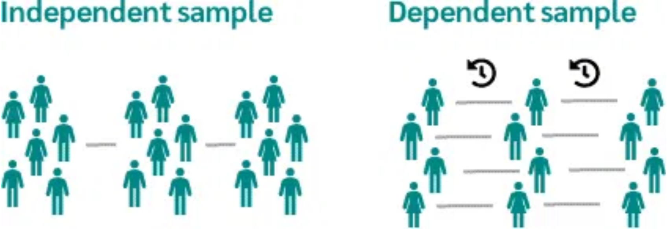
Dependent vs Independent Observations
A key factor in selecting the appropriate statistical test
Independent Observations
Observations or measurements that do not influence each other. Each data point is completely separate from other data points.
Examples:
Statistical Tests Based on Observation Type
Random samples from different populations
Scenario
Independent Observations
Dependent Observations
Different participants in control vs. treatment groups
Measurements from unrelated individuals
Separate experimental units with no connection
Two groups
Independent t-test
Paired t-test
Two groups (non-parametric)
Mann-Whitney U test
Wilcoxon signed-rank test
Dependent Observations
Three+ groups
One-way ANOVA
Repeated Measures ANOVA
Observations or measurements that are related to or influenced by each other. Data points have a natural pairing or connection.
Three+ groups (non-parametric)
Kruskal-Wallis H test
Friedman test
Examples:
Pre-test and post-test measurements on the same subjects
Matched pairs (e.g., twins, before/after)
Repeated measurements over time on the same subjects
Measurements from related groups (e.g., family members)

Slide 7

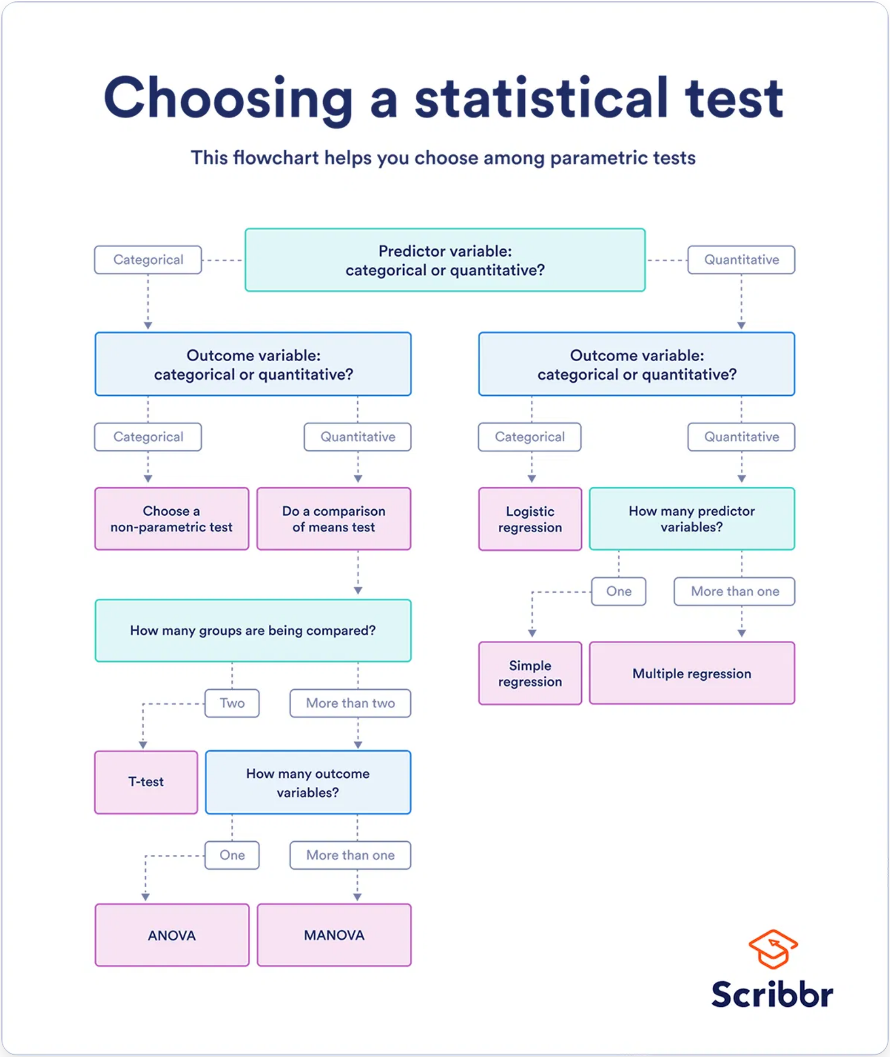
Statistical Test Selection Flowchart
A roadmap to guide your decision-making process
This flowchart provides a high-level overview of the decision points for selecting the appropriate statistical test.

Slide 8

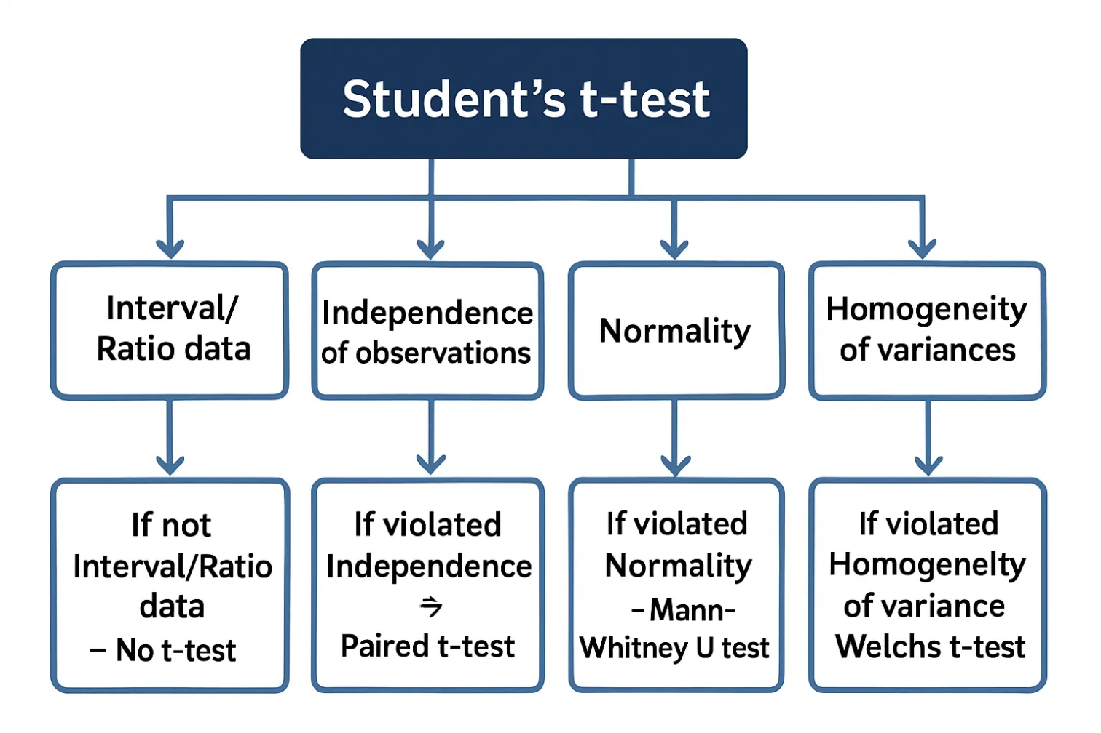
Comparing Two Independent Groups
Research Question: Is there a significant difference between two unrelated groups?
Parametric Option: Student's t-test
Non-parametric Alternative: Mann-Whitney U test
Assumptions:
Interval/Ratio data
When to Use:
Independence of observations
When assumptions for t-test are violated (especially normality/homogeneity).
Normality
Homogeneity of variances
Assumptions:
Assumption Violation Flowchart
When to Use:
Ordinal/Interval/Ratio data
Comparing means of two independent groups.
Independence of observations
Purpose:
Comparing medians (or distributions) of two independent groups when data are not normal or are ordinal.

Slide 9
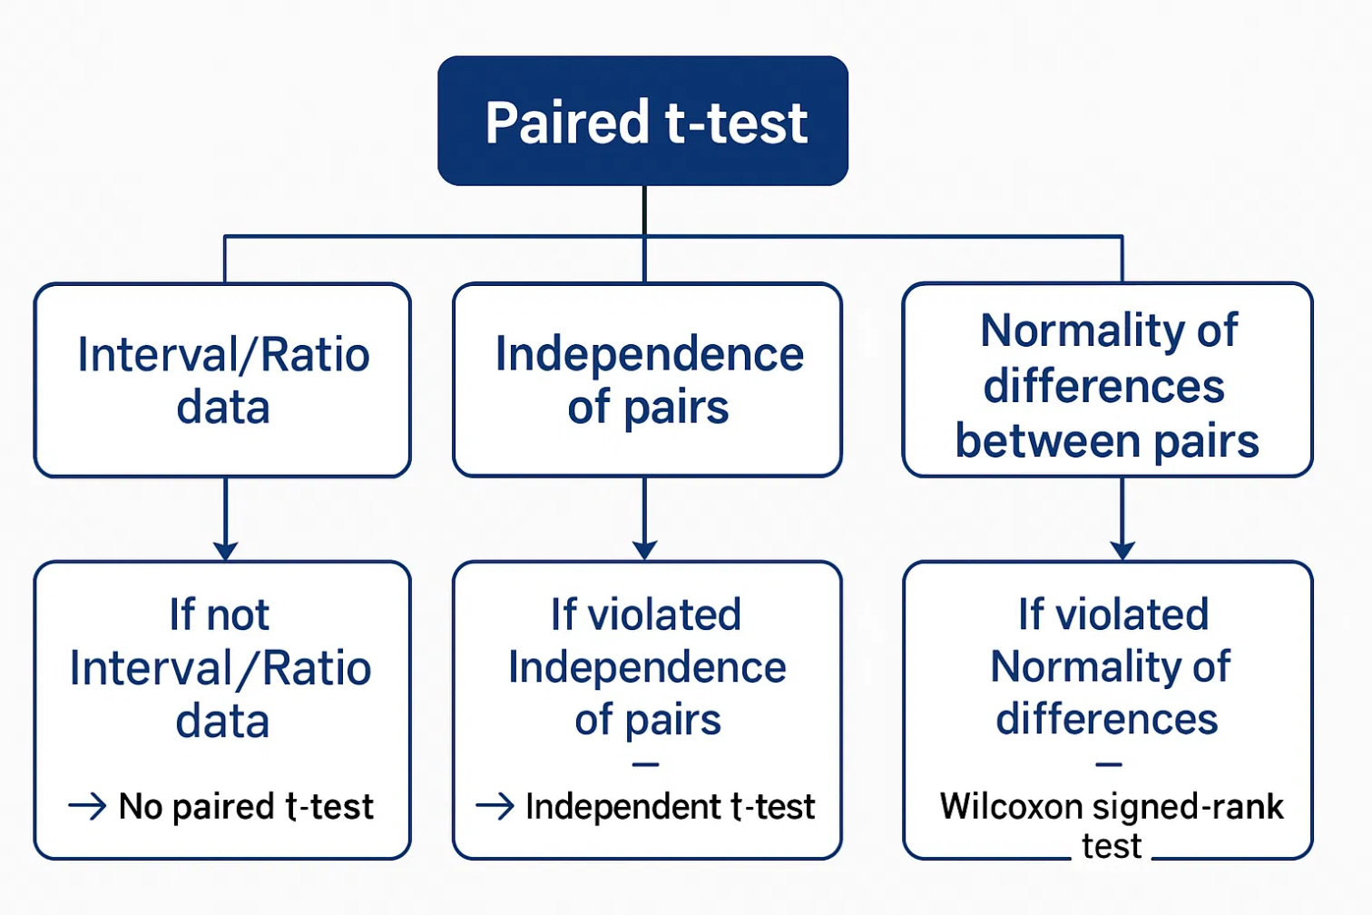
Comparing Two Dependent (Paired) Groups
Research Question: Is there a significant difference between two related measurements?
Parametric Option: Paired t-test
Non-parametric Alternative: Wilcoxon signed-rank test
Assumptions:
Interval/Ratio data
When to Use:
Independence of pairs
When assumptions for paired t-test are violated (especially normality of differences).
Normality of the differences between pairs
When to Use:
Assumptions:
Assumption Violation Flowchart
Comparing means of two paired samples.
Ordinal/Interval/Ratio data
Independence of pairs
Examples: Pre/post measurements, matched pairs, repeated measures on same subjects
Purpose:
Comparing medians (or distributions) of two paired samples when data are not normal or are ordinal.

Slide 10
Comparing Three or More Independent Groups
Research Question: Is there a significant difference among three or more unrelated groups?
Parametric Option: One-way ANOVA
Non-parametric Alternative: Kruskal-Wallis H test
Assumptions:
Interval/Ratio data
When to Use:
Independence of observations
When assumptions for ANOVA are violated (especially normality/homogeneity).
Normality within groups
Homogeneity of variances
Assumptions:
When to Use:
Ordinal/Interval/Ratio data
Comparing means of three or more independent groups.
Independence of observations
Note: If ANOVA shows significance, post-hoc tests (e.g., Tukey's HSD) are needed to determine which specific groups differ.
Purpose:
Comparing medians (or distributions) of three or more independent groups when data are not normal or are ordinal.

Slide 11

Comparing Three or More Dependent Groups
Research Question: Is there a significant difference across three or more related measurements?
Parametric Option: Repeated Measures ANOVA
Non-parametric Alternative: Friedman test
Assumptions:
When to Use:
Interval/Ratio data
When assumptions for Repeated Measures ANOVA are violated.
Independence of subjects
Assumptions:
Normality of differences
Sphericity
Ordinal/Interval/Ratio data
Independence of subjects
When to Use:
Comparing means across three or more related samples.
Purpose:
Comparing medians across three or more related samples when data are not normal.
More Complex/Flexible Option: Mixed-effect Regression
When to Use:
When you have hierarchical or clustered data, repeated measures with missing data, or want to model individual trajectories and group effects simultaneously.
Advantages:
Very flexible and can handle various data types and distributions
Can accommodate missing data points
Allows for modeling of complex relationships
Note: This is a more advanced topic that provides greater flexibility for complex repeated measures or clustered data.

Slide 12

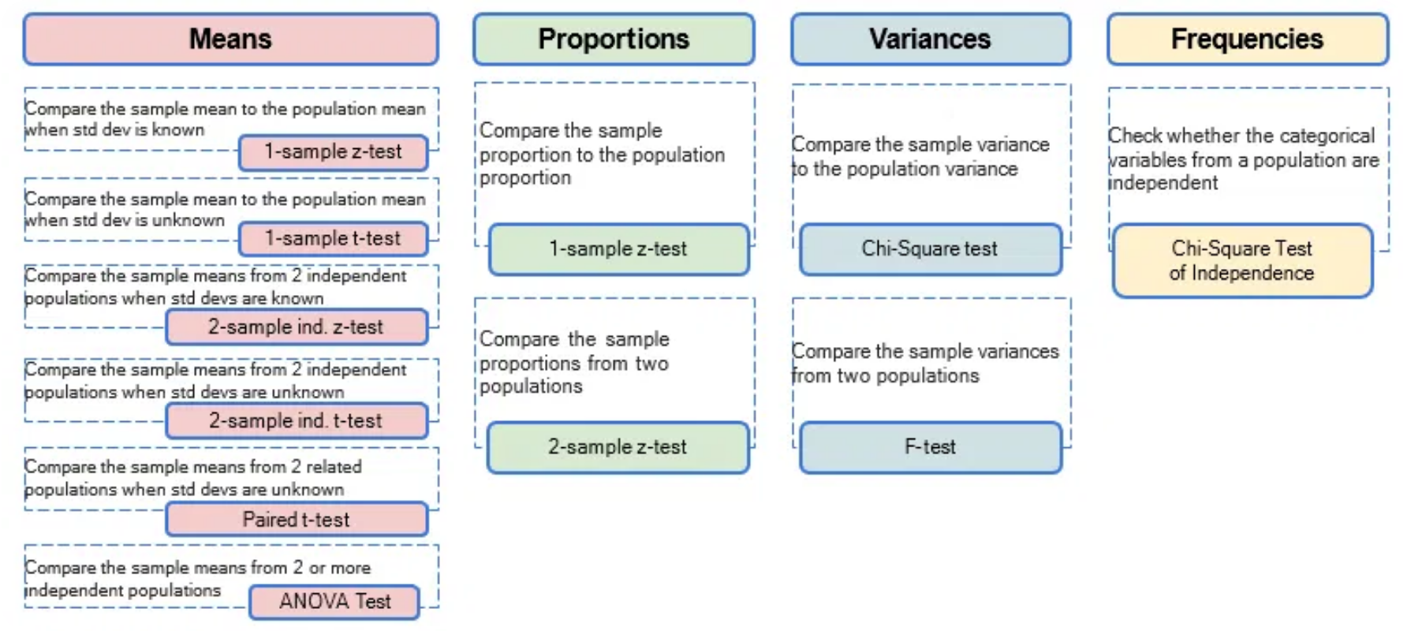
Analyzing Categorical Data
Research Question: Are observed frequencies/proportions different from expected, or is there an association between categorical variables?
For Independent Categorical Data
For Dependent Categorical Data
Chi-square test
McNemar's test
Assumptions:
Assumptions:
Independent observations
Paired nominal data
Expected cell counts > 5 (or a reasonable proportion)
When to Use:
When to Use:
Comparing proportions in paired samples (e.g., before/after intervention on a binary outcome).
Testing association between two categorical variables, or goodness-of-fit for one categorical variable.
Fisher's exact test
Assumptions:
Independent observations
When to Use:
Preferred over Chi-square when expected cell counts are very low (especially in 2x2 tables).

Slide 13

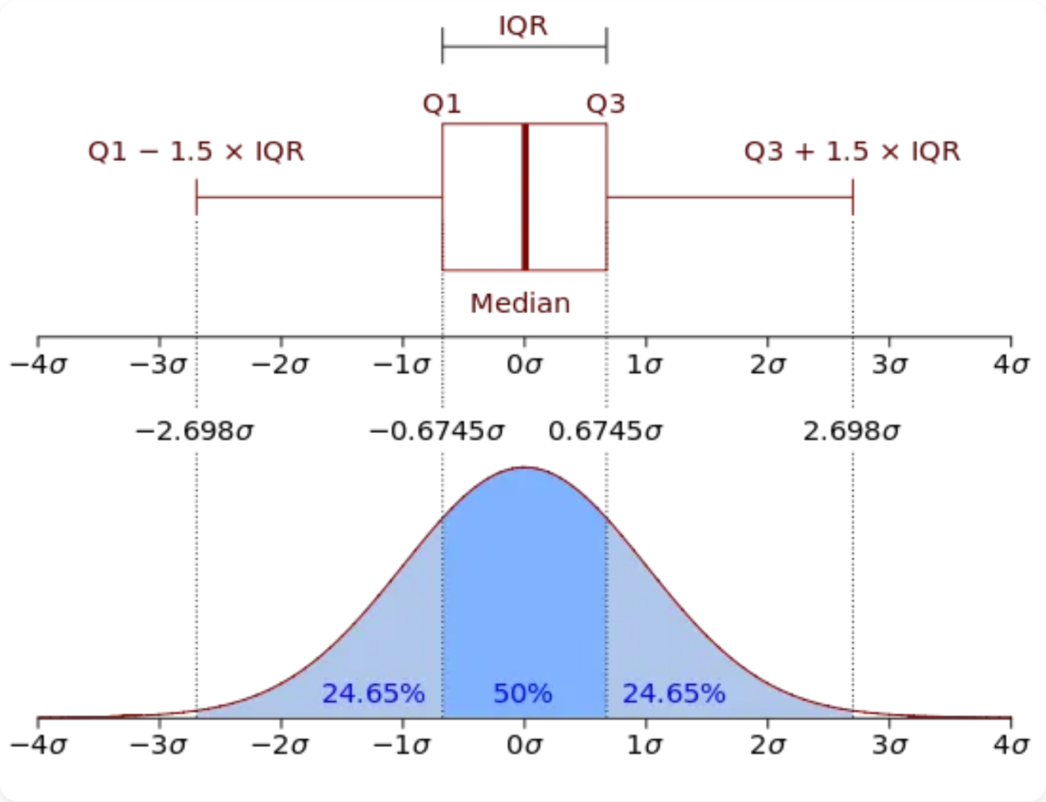


Before You Run the Test: Data Exploration is Key!
Proper exploration helps ensure your test selection is appropriate
Visualizing Data
Use histograms, box plots, and scatter plots to understand your data's distribution and relationships.
Checking for Outliers
Identify and decide how to handle extreme values that may influence your results.
Assessing Normality
Use Q-Q plots and Shapiro-Wilk test to check if your data follows a normal distribution.
Assessing Homogeneity of Variances
Use Levene's test to check if different groups have similar variances.
Visual inspection is often more informative than relying solely on statistical tests for assumptions!

Slide 14

A Checklist for Test Selection
Use this checklist to guide your decision-making process
Question
Your Response
Research Question:
What are you trying to find out?
Number of Variables/Groups:
How many are involved?
Variable Type(s):
Nominal, Ordinal, Interval, Ratio?
Independence of Observations:
Paired or Independent?
Distribution:
Normal or non-normal?
Assumptions Met?
Yes/No
Chosen Test:
Based on above criteria
Alternative Test (if needed):
If assumptions not met
This checklist can be used as a printable handout for future reference.

Slide 15

Thank You!
For taking the time to learn about selecting the right statistical test for your research needs.
Any Questions?

